Slide 1


Capstone Project : Group-2
Amazon Product Review Analysis
Presented by-
Akshay Pawar
Aman Purwar
Abhishek Phadale
Prasad Raikwad

Slide 2

CONTENTS
Objective
Data source
Data description
Tools used
Project flow
Exploratory Data Analysis
Sentiment Analysis
Reasons for Sentiments
Time Series Analysis
Product names
Inter relation between categories
Conclusion
Business Insights

Slide 3

OBJECTIVE
Sentiments of product reviews
Reasons for sentiments
Future trend of sentiments
Inter relation between categories (Digital Music and Musical Instruments)

Slide 4

DATA SOURCE
Amazon product data :
Product reviews
From April 1998 to July 2014
Categories :
1. Digital Music : (64,706 reviews)
2. Musical Instruments : (10,261 reviews)

Slide 5
DATA DESCRIPTION
Features | Description
reviewerID | ID of the reviewer
asin | ID of the product
reviewerName | name of the reviewer
helpful | helpfulness rating of the review
reviewText | text of the review
overall | rating of the product
summary | summary of the review
unixReviewTime | time of the review (unix time)
reviewTime | time of the review (raw)

Slide 6




TOOLS USED
Google Collab
Tableau
Power Point
Excel

Slide 7
PROJECT FLOW
PROBLEM STATEMENT
DATA UNDERSTANDING & PREPROCESSING
EDA
SETIMENT ANALYSIS
FORECASTING SENTIMETS
Performing EDA to get insights & forming story on basis of visuals which can be helpful for understand the business & customers
Understanding the Problem statement to meet business objective.
Analyzing Sentiments according to polarity score using TextBlob and VADER sentiment analysis
Building time series SARIMA model to predict future sentiments of products
Forming data dictionary to understand the features, dataset & dealing with null/missing values.

Slide 8
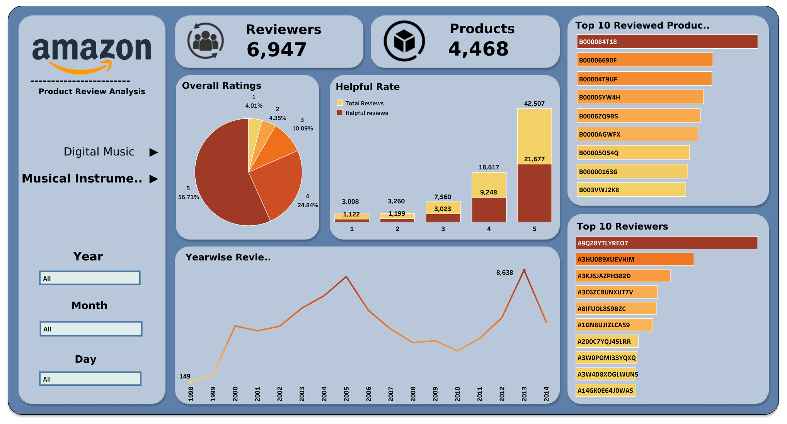
EXPLORATORY DATA ANALYSIS
For Tableau Dashboard Click here

Slide 9
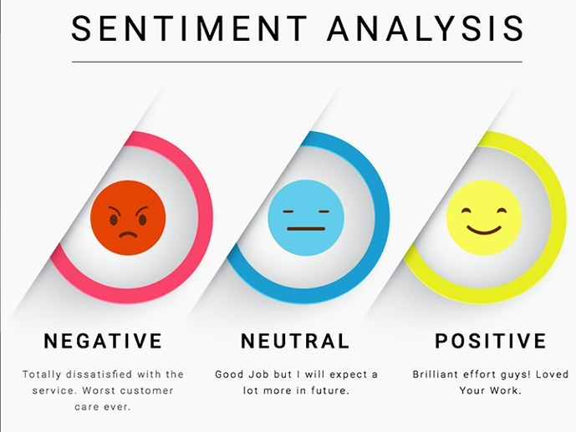
SENTIMENT ANALYSIS
1. Sentiment analysis on Reviews and summaries.
2. Sentiment Analysis methods :
Method 1 : TextBlob polarity score
Method 2 : VADER (Valence Aware Dictionary for Sentiment Reasoning) Sentiment Analysis
3. Checking random 20 reviews manually for comparing both methods
4. Accuracy :
TextBlob : 50%
VADER : 70%
5.VADER Sentiment compound score are more
accurate towards the sentiments of the reviews

Slide 10

REASONS FOR SETIMENTS
Products with most negative and positive reviews from each category (Digital Music and Musical Instruments)
Methods used :
N-gram words of reviews (Trigram and 4-gram)
ATEPC (Aspect Term Extraction Polarity Classification) Method
n-gram words of reviews not getting exact reasons
ATEPC method gives sentiment confidence words which helps in finding reasons

Slide 11
CNTD…
NEGATIVELY REVIEWED PRODUCTS
Digital Music
Product Id | Product Name | Reasons
B0007NFL18 | The Massacre by 50 Cent | Lyrics and beats was not good. The hype of artist is starting to fade.
B000084T18 | Get Rich Or Die Tryin' by 50 Cent | The artist was targeting some other artists which was not going well with the fans.
B00004T9UF | The Marshall Mathers by Eminem | Language used by the artist was not appropriate.
B0000TAZS8 | Beg for Mercy by G-unit | In the Group of artist name as "G-Unit” other than 50 Cents other artist failed to make any impact on the audience.
B00065XJ52 | Encore by Eminem | Songwriting and production was not good.

Slide 12
CNTD…
NEGATIVELY REVIEWED PRODUCTS
Musical Instruments
Product Id | Product Name | Reasons
B0002E1G5C | Planet Waves DP0002 Pro String Winder and Cutter | The String winder tool for guitars is not working properly.
B000068NW5 | Hosa GTR-210 Straight Guitar Cable, 10 feet | The Hosa cable gives crackling sound while plug-in to the amplifier. The length of the cable is very short. The threads of the cable peels off easily.
B0002GLDQM | Dunlop Pick holder | The pick holder carries only 3 pick instead of what the company claimed of 6. The color of the product is not the same as shown on the site.
B003VWJ2K8 | Snark SN-1 Clip-On Guitar and Bass Tuner | The quality of the product is not good and it drains the battery very quickly.
B0002CZW0Y | Nady MPF-6 6-inch Clamp On Microphone Pop Filter with Flexible Gooseneck and Metal Stabilizing Arm | The alignment of Pop filter is slightly off center.

Slide 13
CNTD…
CNTD…
POSITIVELY REVIEWED PRODUCTS
Digital Music
Product Id | Product Name | Reasons
B000084T18 | Get Rich Or Die Tryin' by 50 Cent | Worth the money
B0007NFL18 | The Massacre by 50 Cent | Inspirational, joy and positive vibes
B00005YW4H | Come Away with Me by Norah Jones | Artist's voice is amazing. Calming music.
B00006690F | Eminem Show by Eminem | Lyrics are extraordinary from the beloved artist
B0000AGWFX | Speakerboxxx: Love Below by Outkast | High energy, great vocals and ecstatic beats

Slide 14
CNTD…
POSITIVELY REVIEWED PRODUCTS
Musical Instruments
Product Id | Product Name | Reasons
B003VWJ2K8 | Snark SN-1 Clip-On Guitar and Bass Tuner | Works very well and easier to read
B0002E1G5C | Planet Waves DP0002 Pro String Winder and Cutter (Multicolor) | Winder winds the string quite well with attached cutter cuts the excessive strings cleanly.
B0002F7K7Y | D'Addario Electric Regular {Light Gauge10/46 BRIGHT TONE ROUND WOUND} Guitar Strings (Bronze) | Good Quality & Durable, break in quickly and hold there tune properly. Works for all styles of play.
B003VWKPHC | Snark SN-2 All Instrument Clip-On Chromatic Tuner | It is versatile product and works on various musical instruments (guitar, trumpet, etc.) and also works on mics. Delivery is fast as well.
B0002H0A3S | D'Addario EJ26 Acoustic 11-52 Custom Light Guitar Strings | Packaging is good and price is reasonable. It is copper coated hence more durable.

Slide 15

TIME SERIES ANALYSIS
Model used: SARIMA (Seasonal Autoregressive Integrated Moving Average)

Slide 16
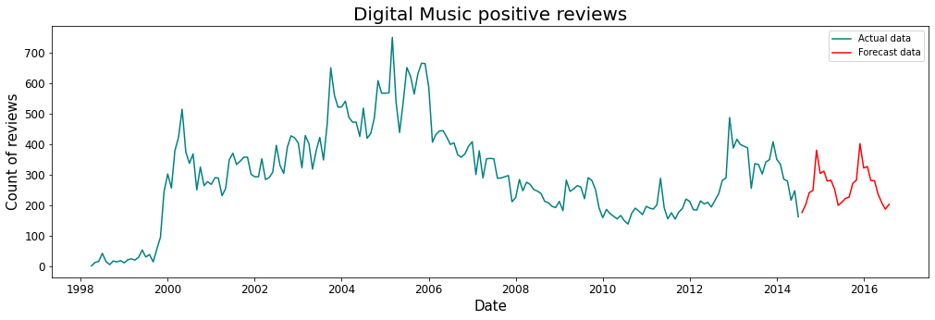
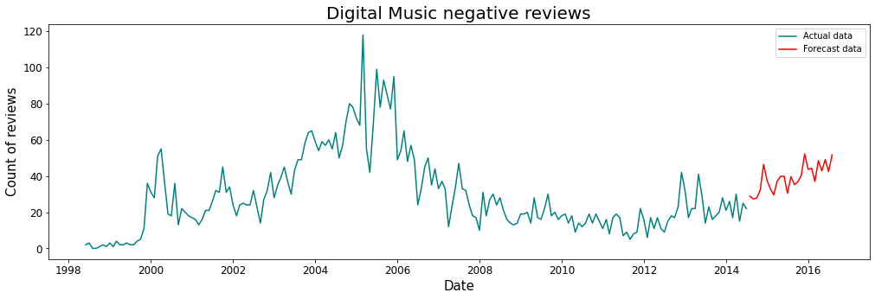
CNTD…
Digital Music
Positive Sentiments
INSIGHTS:
1. Positive reviews tends to be constant after July 2014 till July 2016
2. Negative reviews tends to be increasing after July 2014 till July 2016
Negative Sentiments

Slide 17
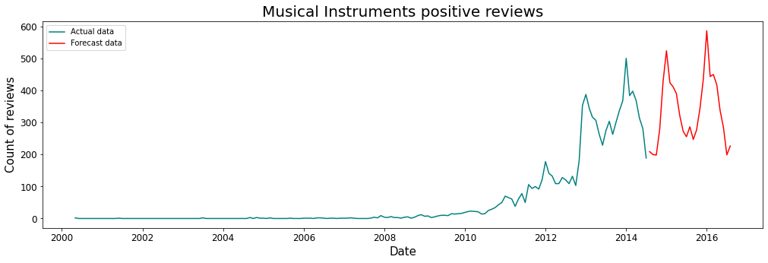
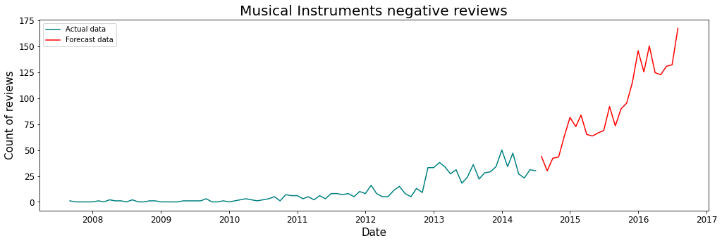
CNTD…
Musical Instruments
Positive Sentiments
INSIGHTS:
1. Positive reviews tends to be slightly increasing after July 2014 till July 2016
2. Negative reviews tends to be increasing after July 2014
till July 2016
Negative Sentiments

Slide 18

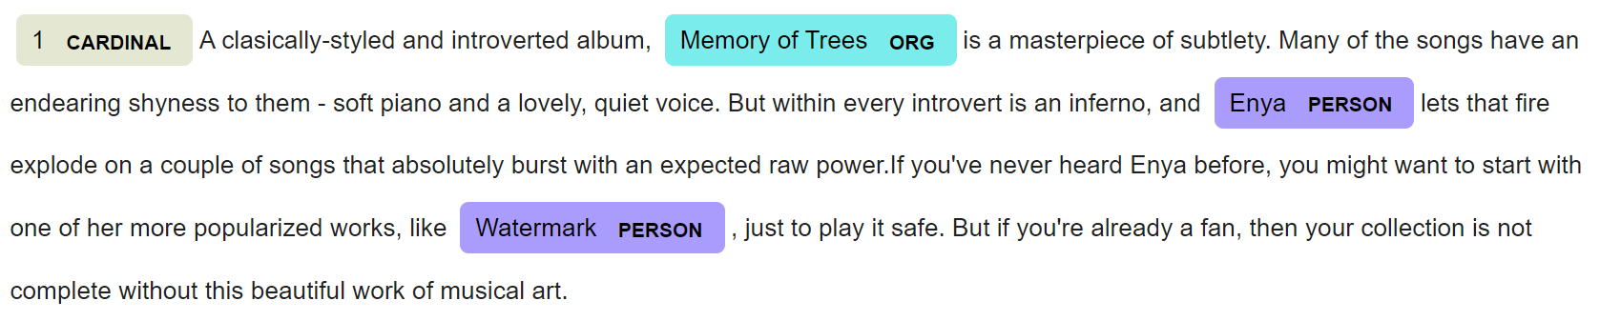
PRODUCT NAMES
Finding reviews for unique product ID
Method used : NER (Name Entity Recognization) method
Product names comes under ORG (Organization) tag
Example :

Slide 19
CNTD…
Digital Music
Product ID | Product Name
5555991584 | The Memory of Trees (Studio album by Enya)
B0000000ZW | Changing Faces (by) R&B (duo)
B00000016T | Candy-O (Song by The) Cars
B00000016W | Surfin’ USA (Song by) Brian Wilson (and The) Beach Boys
B00000017R | Samba de uma Nota Só (Samba de uma nota só Song by) Antônio Carlos Jobim
B0000001P4 | That Secret Place (by) Patti
B0000002HZ | Too Late To Cry (by) Alison Krauss (and) Union Station Alison Krauss
B0000002J9 | Two Highways (by) Alison Krauss
B0000002JR | I've Got That Old Feeling (by) Alison Krauss
B0000002ME | Now That I've Found (by) Alison Krauss

Slide 20
CNTD…
Musical Instrument
Product ID | Product Name
B0002D0096 | Roland MICRO-CUBE (Guitar Combo) Amplifier
B0002CZV82 | Boss DS-1 (Distortion Pedal by) BOSS
B0000AQRSU | Shure SM58S (Vocal Microphone with On/Off Switch)
B0002CZV7I | Boss CS-3 (Compressor/Sustainer Pedal)
B0002CZUUG | Epiphone LP (Special II) Les Paul (Electric Guitar), Ebony
B0002CZST4 | Martin M170 (Acoustic 80/20 Guitar Strings, Extra Light)
B0002CZSJO | Kyser KG6S (Quick-Change Capo for 6 String Acoustic Guitar, Silver)
B0002BACB4 | Shure Beta 58A (Unidirectional Auxiliary Dynamic Vocal Microphone)
B000068O1N | Hosa STP-201 (1/4 inch TRS to Dual 1/4 inch TS Insert Cable, 3.3 feet)
B000068NW5 | Hosa GTR-210 (Straight Guitar Cable, 10 feet)

Slide 21
INTER RELATION BETWEEN CATEGORIES
1. Common Reviewers
Categories :
Digital Music
Musical Instruments
INSIGHTS :
Total 30 common reviewers from both categories
Sr. no. | Reviewer ID | Reviewer Name
1 | A2NYK9KWFMJV4Y | Mike Tarrani "Jazz Drummer“
2 | A1LQC225SE8UNI | David Burch
3 | A13A81NN0NRD1S | aspiring saint ("TATITTLE“)
4 | A3V1A3C9DTLPME | Peter Faden ("robilar5500“)
5 | A6FIAB28IS79 | Samuel Chell
6 | A18X6ZT4AEYVKB | Yeemeister
7 | A1MI9FDCNB3CMR | Jorge Barbarosa "the_bassist"
8 | A2C7BOQVFH1HLE | Frederick Baptist
9 | ADH0O8UVJOT10 | StormJH1
10 | A27L5L6I7OSV5B | Otto Correct
11 | A356RFKNIG043B | K. Swanson
12 | A2NOZB6VZCTOI4 | Robert I. Hedges
13 | AN5QXK8A9F8LH | S. O. "soo"
14 | A3EXWV8FNSSFL6 | Daniel G. Lebryk
15 | A2KKZHISX9YKMI | PJY "pjsailor"
Sr. no. | Reviewer ID | Reviewer Name
16 | A2VSNUK7YLRKRE | F. Sasso "Stupidity Should Hurt"
17 | A2CARFAX5FNQT9 | McEldoy
18 | A2U7DXDNYBBLQJ | Shane Windham "Shane Windham, author"
19 | A2OPSPL8LSSJPC | Jared Jennings
20 | A2EW01G2LNJN06 | Z. Mehrbach "Zach"
21 | AWCJ12KBO5VII | Michael L. Knapp
22 | ACY9QYNDFLVBI | G. Farnsworth
23 | A1T9SCT89JJ96 | David Townsend
24 | A3EBHHCZO6V2A4 | Amaranth "music fan"
25 | AZPWAXJG9OJXV | bethtexas
26 | A38IRL0X2T4DPF | bob turnley
27 | A22IK3I6U76GX0 | Calle
28 | A1AISPOIIHTHXX | Cloud "..."
29 | A2P49WD75WHAG5 | Daniel J. Hamlow
30 | A3O90G1D7I5EGG | dev1

Slide 22
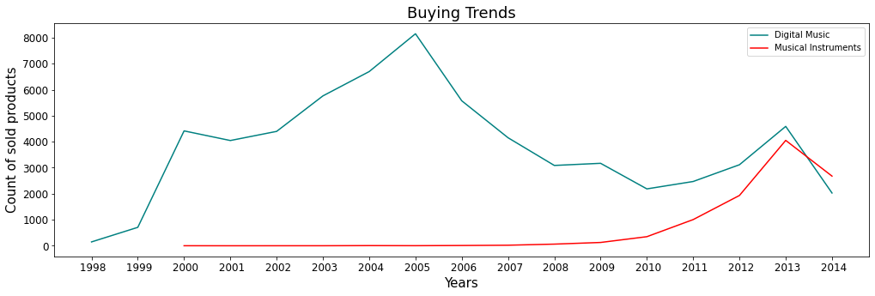
2. Buying Trends
INSIGHTS:
Digital Music category products shows higher sales than Musical Instrument category products.
Amazon started to sell Digital Music category products from year 1998 and for Musical Instruments category products from year 2000
Musical Instruments category products are giving very less to no sales till 2010.
Digital music category product's sales increases from 1998 till 2005. After 2005 the sales get reduces.
After 2010 till 2013 sales of both category products increases.

Slide 23
CONCLUSION
1. Positive sentiment (strongly positive and positive) reviews are more in number than negative sentiment (Neutral, negative and strongly negative) reviews
2. Reasons for sentiments
A. Negative :
Digital Music : lyrics, beats, language and production not good
Musical instruments : Degraded quality, poor working, products is not same as shown on site
B. Positive :
Digital Music : lyrics are extraordinary, inspirational, positive and joyful. Artist’s Vocals amazing.
Musical instruments : Good quality, durable. Packaging good. Delivery fast.
3. Most sold albums are by 50 Cent (The Massacre, Get Rich Or Die Tryin’)
4. Most sold products are string instruments such as guitars and guitar accessories (Snark SN-1 Clip-on Guitar and Bass Tuner, D'Addario Guitar strings)
5. Total 30 common reviewers in both categories
6. Digital music category products gives higher sales than musical instruments

Slide 24
BUSINESS INSIGHTS
Amazon music app was launched 25 September, 2007. Hence, sales of Digital Music (CD) got decreased
Streaming music on digital platform advantages :
Easy accessibility
Better sound quality
Since, musical instruments are very fragile hence, work on their logistic department for careful handling and good packaging
Introduce ‘Used products musical instruments’ section
To increase sales in musical instruments category focus on digital marketing more

Slide 25
THANK YOU !!!

